Slide 1
Python Programming: An Introduction to Computer Science
Chapter 3
Computing with Numbers

Slide 2
Objectives
To understand the concept of data types.
To be familiar with the basic numeric data types in Python.
To understand the fundamental principles of how numbers are represented on a computer.
To be able to use the Python math library.
To be able to read and write programs that process numerical data.

Slide 3
3.1 Numeric Data Types
The information that is stored and manipulated by computers programs is referred to as data.
See the following example:

Slide 4
def change():
print ("Change Counter")
print ()
print ("Please enter the count of each coin type. ")
quarters = eval (input ("Quarters: ") )
dimes = eval (input ("Dimes: ") )
nickels = eval (input ("Nickels: ") )
pennies = eval (input ("Pennies: ") )
total = quarters * .25 + dimes * .10 + nickels * .05 + pennies *0.01
print ()
print ("The total value of your change is", total)
>>> change()
Change Counter
Please enter the count of each coin type.
Quarters: 2
Dimes: 1
Nickels: 3
Pennies: 1
The total value of your change is 0.76

Slide 5
3.1 Numeric Data Types
There are two different kinds of numbers in the example!
(2, 1, 3, 1) are whole numbers – they don’t have a fractional part
(.25, .10, .05, .01) are decimal fractions
Inside the computer, whole numbers and decimal fractions are represented quite differently!
We say that decimal fractions and whole numbers are two different data types.
The data type of an object determines what values it can have and what operations can be performed on it.

Slide 6
3.1 Numeric Data Types
Whole numbers are represented using the integer (int for short) data type.
These values can be positive or negative whole numbers.

Slide 7
3.1 Numeric Data Types
Numbers that can have fractional parts are represented as floating point (or float) values.
How can we tell which is which?
A numeric literal without a decimal point produces an int value
A literal that has a decimal point is represented by a float (even if the fractional part is 0)

Slide 8
3.1 Numeric Data Types
Python has a special function to tell us the data type of any value.
>>> type(3)
<class 'int'>
>>> type(3.1)
<class 'float'>
>>> type(3.0)
<class 'float'>
>>> myInt = 32
>>> type(myInt)
<class 'int'>

Slide 9
3.1 Numeric Data Types
Why do we need two number types?
Program style---values that represent counts can’t be fractional (you can’t have 3 ½ quarters)
Most mathematical algorithms are very efficient with integers
The float type stores only an approximation to the real number being represented!
Since floats aren’t exact, use an int whenever possible!

Slide 10
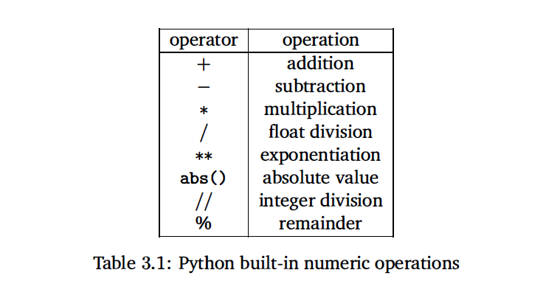
3.1 Numeric Data Types
A value's data type determines what operations can be used on it. Python supports the usual mathematical operations on numbers.

Slide 11
3.1 Numeric Data Types
Operations on ints produce ints, operations on floats produce floats (except for /).
>>> 3.0+4.0
7.0
>>> 3+4
7
>>> 3.0*4.0 What’s the type for each of them, 3.0*4.0 and 3*4?
12.0
>>> 3*4
12

Slide 12
3.1 Numeric Data Types
>>> 10.0/3.0
3.3333333333333335
>>> 10/3
3.3333333333333335
>>> 10 // 3
3
>>> 10.0 // 3.0
3.0
How about 10//3?
How about 10.0//3, and 10//3.0?

Slide 13
3.1 Numeric Data Types
Integer division produces a whole number.
10//3 = 3.
10%3 = 1 is the remainder of the integer division of 10 by 3.
a = (a/b)(b) + (a%b)

Slide 14
Practice problem
Show the result of evaluating each expression. Indicate its type (int or float). If the expression is illegal, explain why.
4.0/10.0 + 3.5*2
10 % 4 + 6 / 2
abs (4 - 20 // 3)** 3
sqrt (4.5 - 5.0) + 7 *3
3 * 10 // 3 + 10% 3
3 ** 3
4.0/10.0 + 3.5*2=7.4, float
10 % 4 + 6 / 2=5, int
abs (4 - 20 // 3)** 3=8, int
sqrt (4.5 - 5.0) + 7 *3 illegal
3 * 10 // 3 + 10% 3=11, int
3 ** 3=27, int

Slide 15

Homework
1. Write a program to calculate the volume and surface area of a sphere from its radius, given as input. Here are some formulas that might be useful:

Slide 16
3.2 Type Conversions and Rounding
In general, converting a float to an int is a dangerous step, because some information (the fractional part) will be lost.
In mixed-typed expressions, Python will automatically convert ints to floats and perform floating-point operations to produce a float result.

Slide 17
3.2 Type Conversions and Rounding
Class example
>>> int (4.5)
>>> int (3.9)
>>> float (4)
>>> float (4.5)
How about float(int(4.5))? Will we get 4.5?

Slide 18
3.2 Type Conversions and Rounding
A more general way of rounding off numbers is to use the built-in round function, which rounds a number to the nearest whole value.
>>> round (3.14)
3
>>> round (3.5)
4
>>> pi = 3.141592653589793
>>> round(pi,3)
3.142

Slide 19
3.2 Type Conversions and Rounding
Using int and float can make a secure way for getting numeric data from users.
Recall the class change.py program, we do the following test.
>>> change()
Change Counter
Please enter the count of each coin type.
Quarters: 1.5
Dimes: 3.5
Nickels: 4.5
Pennies: 0.23
The total value of your change is 0.9523

Slide 20
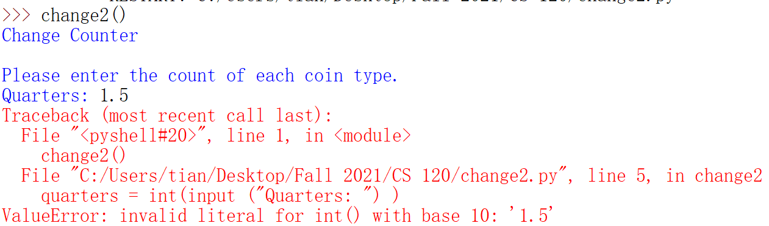
3.2 Type Conversions and Rounding
Do the following change by using int function
quarters = int (input ("Quarters: ") )
dimes = int (input ("Dimes: ") )
nickels = int (input ("Nickels: ") )
pennies = int (input ("Pennies: ") )

Slide 21
3.3 Using the Math Library
Besides (+, -, *, /, //, **, %, abs), we have lots of other math functions available in a math library.
A library is a module with some useful definitions/functions.

Slide 22
3.3 Using the Math Library
Class example:
Let’s write a program to compute the roots of a quadratic equation!
The only part of this we don’t know how to do is find a square root… but it’s in the math library!

Slide 23
3.3 Using the Math Library
To use a library, we need to make sure this line is in our program: import math
Importing a library makes whatever functions are defined within it available to the program.

Slide 24
3.3 Using the Math Library
To access the sqrt library routine, we need to access it as math.sqrt(x).
Using this dot notation tells Python to use the sqrt function found in the math library module.
To calculate the root, we can do discRoot = math.sqrt(b*b – 4*a*c)

Slide 25
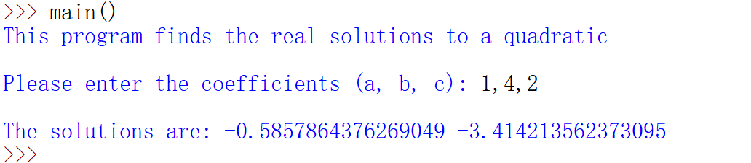
3.3 Using the Math Library
import math
def main():
print("This program finds the real solutions to a quadratic")
print()
a, b, c = eval(input("Please enter the coefficients (a, b, c): "))
discRoot = math.sqrt(b * b - 4 * a * c)
root1 = (-b + discRoot) / (2 * a)
root2 = (-b - discRoot) / (2 * a)
print()
print("The solutions are:", root1, root2 )

Slide 26
3.3 Using the Math Library
There will be an error if it do not have real solutions.
This program finds the real solutions to a quadratic
Please enter the coefficients (a, b, c): 1, 2, 3
Traceback (most recent call last):
File "<pyshell#26>", line 1, in -toplevel-
main()
File "C:\Documents and Settings\Terry\My Documents\Teaching\W04\CS 120\Textbook\code\chapter3\quadratic.py", line 14, in main
discRoot = math.sqrt(b * b - 4 * a * c)
ValueError: math domain error
If a = 1, b = 2, c = 3, then we are trying to take the square root of a negative number!

Slide 27
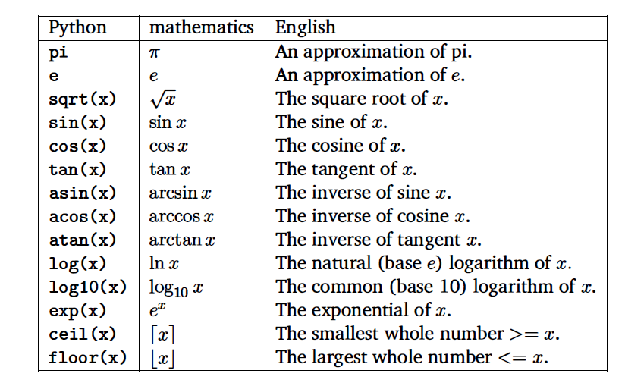
3.3 Using the Math Library
Generally, if your program requires a common mathematical function, the math library is the first place to look.

Slide 28

Class example
Write a program that accepts two points (see previous problem) and determines the distance between them.

Slide 29
Class example
Need to use the function
eval(input(“Please enter the point (x,y)”))
to get the two points.
Need to borrow the build in function, sqrt, or math.sqrt.

Slide 30
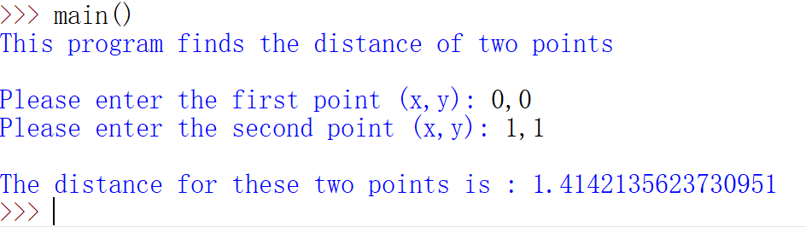
Class example
import math
def main():
print("This program finds the distance of two points")
print()
x1,y1= eval(input("Please enter the first point (x,y): "))
x2,y2= eval(input("Please enter the second point (x,y): "))
distance = math.sqrt((x1-x2)**2 +(y1-y2)**2)
print()
print("The distance for these two points is :", distance )

Slide 31
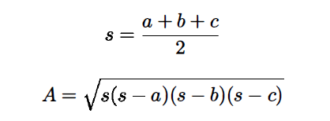
Practice problem
Write a program to calculate the area of a triangle given the length of its three sides-a, b, and c-using these formulas:

Slide 32
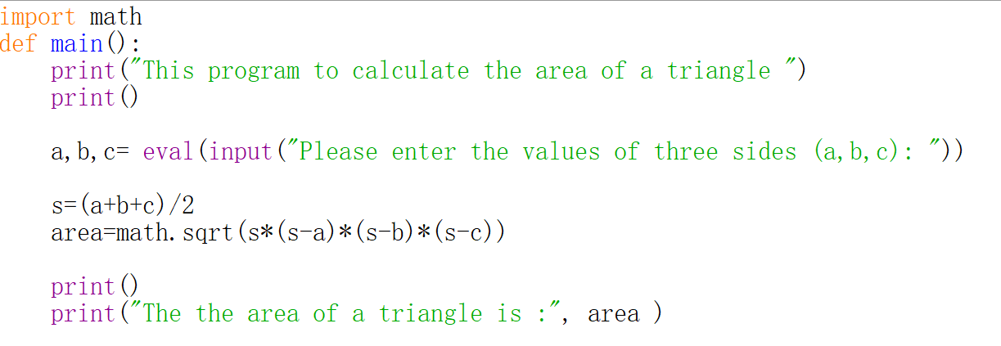
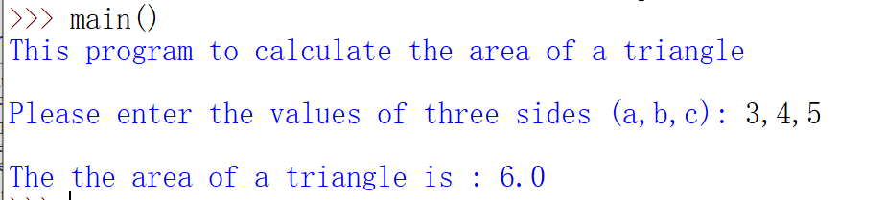
Practice problem

Slide 33


Homework
2. Write a program to determine the length of a ladder required to reach a given height when leaned against a house. The height and angle of the ladder are given as inputs. To compute length use the following formulas:
Note: The angle must be in radians. Prompt for an angle in degrees and
use this formula to convert:

Slide 34
3.4 Accumulating Results: Factorial
In mathematics, factorials are often denoted with an exclamation point (!).
The factorial of a whole number n is defined as
n! = n(n - 1)(n- 2) ... (1).
Say you are waiting in a line with five other people. How many ways are there to arrange the six people?
720 -- 720 is the factorial of 6 (abbreviated 6!)
6! = 6*5*4*3*2*1 = 720

Slide 35
3.4 Accumulating Results: Factorial
How could we write a Python program to do it?
Input number to take factorial of, n
Compute factorial of n, named as fact
Output fact

Slide 36
3.4 Accumulating Results: Factorial
Let’s get the idea for the process.
Take 6! As an example.
How did we calculate 6!?
6*5 = 30
Take that 30, and 30 * 4 = 120
Take that 120, and 120 * 3 = 360
Take that 360, and 360 * 2 = 720
Take that 720, and 720 * 1 = 720

Slide 37
3.4 Accumulating Results: Factorial
We’re doing repeated multiplications, and we’re keeping track of the running product.
This algorithm is known as an accumulator, because we’re building up or accumulating the answer in a variable, known as the accumulator variable.

Slide 38
3.4 Accumulating Results: Factorial
The general form of an accumulator algorithm looks like this:
Initialize the accumulator variable
Loop until final result is reached update the value of accumulator variable

Slide 39
3.4 Accumulating Results: Factorial
The program:
fact = 1
for factor in [6, 5, 4, 3, 2, 1]: fact = fact * factor

Slide 40
3.4 Accumulating Results: Factorial
Why did we need to initialize fact to 1?
Each time through the loop, the previous value of fact is used to calculate the next value of fact. By doing the initialization, you know fact will have a value the first time through.
If you use fact without assigning it a value, what does Python do?

Slide 41
3.4 Accumulating Results: Factorial
The multiplication is associative and commutative, we can rewrite our program as:
fact = 1
for factor in [2, 3, 4, 5, 6]: fact = fact * factor
How about the general case?

Slide 42
3.4 Accumulating Results: Factorial
What does range(n) return? 0, 1, 2, 3, …, n-1
range has another optional parameter range(start, n) start, start + 1, …, n-1
And range(start, n, step) start, start+step, …, n-1
list(<sequence>) to make a list

Slide 43
3.4 Accumulating Results: Factorial
Let’s try some examples!
>>> list(range(10))
[0, 1, 2, 3, 4, 5, 6, 7, 8, 9]
>>> list(range(5,10))
[5, 6, 7, 8, 9]
>>> list(range(5,10,2))
[5, 7, 9]

Slide 44
Practice problem
Show the sequence of numbers that would be generated by each of the following range expressions.
a) range (5)
b) range (3, 10)
c) range (4, 13, 3)
d) range (15, 5, -2)
e) range (5, 3)
a) range (5) [0,1,2,3,4]
b) range (3, 10), [3,4,5,6,7,8,9]
c) range (4, 13, 3), [4,7,10]
d) range (15, 5, -2), [15,13,11,9,7]
e) range (5, 3), [] # empty

Slide 45
3.4 Accumulating Results: Factorial
Using this range statement, we can do the range for our loop a couple different ways.
We can count up from 2 to n: range(2, n+1) (Why did we have to use n+1?)
We can count down from n to 2: range(n, 1, -1)

Slide 46
3.4 Accumulating Results: Factorial
# factorial.py
# Program to compute the factorial of a number
def main():
n = eval(input("Please enter a whole number: "))
fact = 1
for factor in range(n,1,-1):
fact = fact * factor
print("The factorial of", n, "is", fact)

Slide 47
3.4 Accumulating Results: Factorial
>>> main()
Please enter a whole number: 10
The factorial of 10 is 3628800
>>> main()
Please enter a whole number: 6
The factorial of 6 is 720

Slide 48
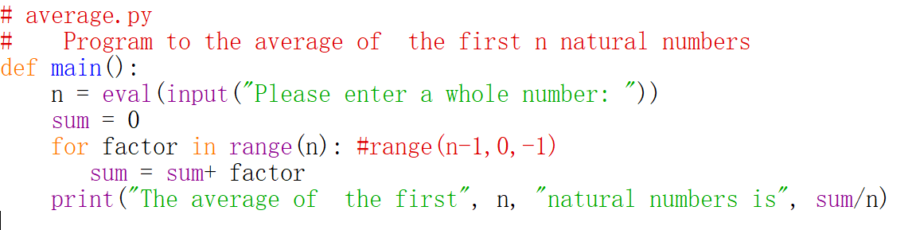
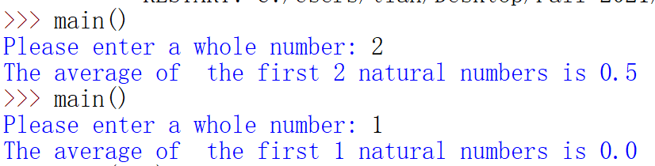
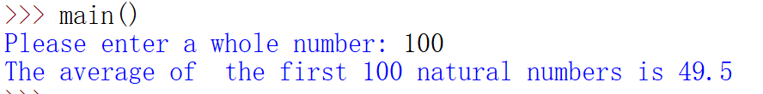
Practice problem
Write a program to find the average of the first n natural numbers, where the value of n is provided by the user.

Slide 49
Homework
3. Write a program that finds the average of a series of numbers entered by the user.
Hint: You need to ask the user how many numbers there are first.
4. Write a program to find the sum of the cubes of the first n natural numbers where the value of n is provided by the user.

Slide 50
3.5 The Limits of Int
Continuing with the class example: factorial
What is 100!?
>>> main()
Please enter a whole number: 100
The factorial of 100 is 93326215443944152681699238856266700490715968264381621468592963895217599993229915608941463976156518286253697920827223758251185210916864000000000000000000000000

Slide 51
3.5 The Limits of Int
Newer versions of Python can handle it, but older versions of Python may have some problems.
What’s going on?
While there are an infinite number of integers, there is a finite range of ints that can be represented.
This range depends on the number of bits a particular CPU uses to represent an integer value. Typical PCs use 32 bits.

Slide 52
3.5 The Limits of Int
Typical PCs use 32 bits
That means there are 2³² possible values, centered at 0.
This range then is –2³¹ to 2³¹-1. We need to subtract one from the top end to account for 0.
But our 100! is much larger than this. How does it work?

Slide 53
3.5 The Limits of Int
Does switch to float data types fix the limitations of ints?
>>> main()
Please enter a whole number: 15
The factorial of 15 is 1.307674368e+012
We no longer get an exact answer!

Slide 54
3.5 The Limits of Int
Very large and very small numbers are expressed in scientific or exponential notation.
1.307674368e+012 means 1.307674368 * 10¹²
Here the decimal needs to be moved right 12 decimal places to get the original number, but there are only 9 digits, so 3 digits of precision have been lost.

Slide 55
3.5 The Limits of Int
Floats are approximations
Floats allow us to represent a larger range of values, but with lower precision.
Python has a solution, expanding ints!
Python Ints are not a fixed size and expand to handle whatever value it holds.

Slide 56
3.5 The Limits of Int
Newer versions of Python automatically convert your ints to expanded form when they grow so large as to overflow.
We get indefinitely large values (e.g. 100!) at the cost of speed and memory

